Slide 1
Christian Doud
Tanner Jackson

Slide 2
System Description
Web-based platform for tracking and managing Super Smash Brothers (SSB) tournament statistics
Players/Users can search and sort by tournament, player, character, etc
Admins can add, update, and delete information from tournaments
System updates player stats based on match results and supports character tracking
The system enhances the SSB tournament experience with organized data and insights

Slide 3
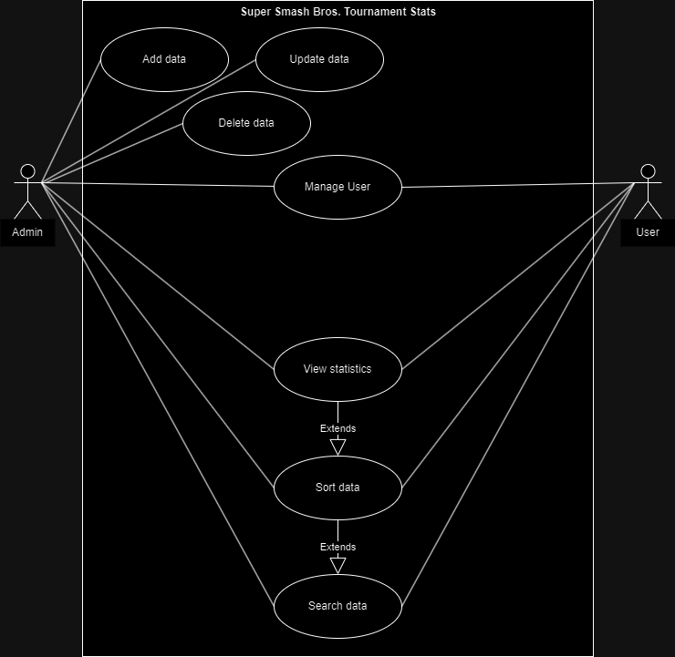
Use-Case Diagram

Slide 4
E/R Diagram

Slide 5
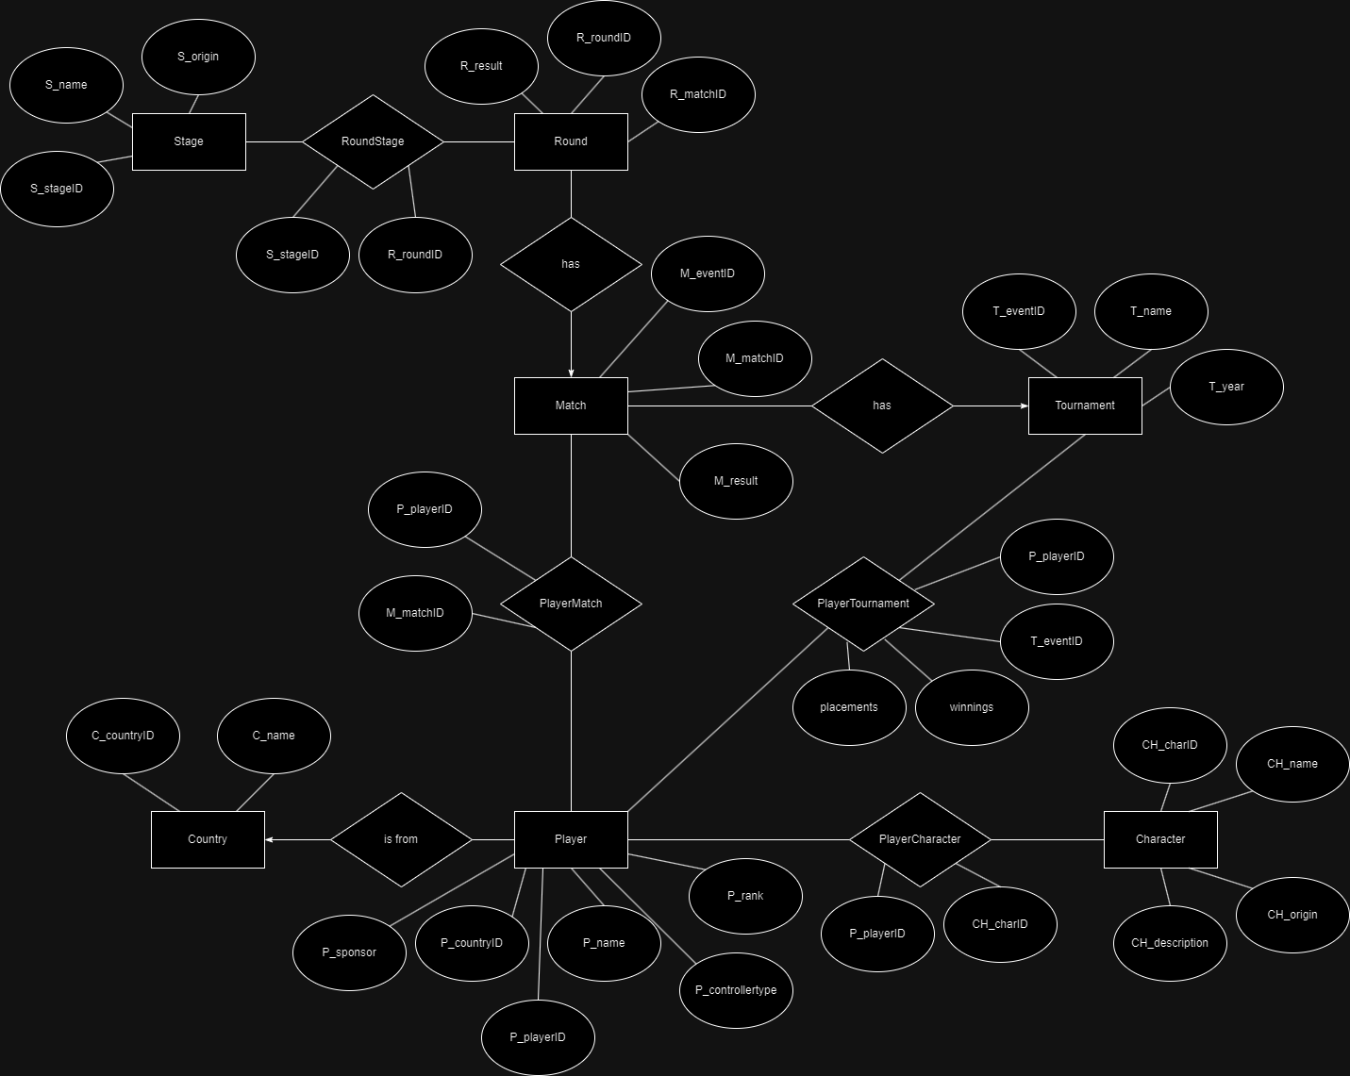

Slide 6
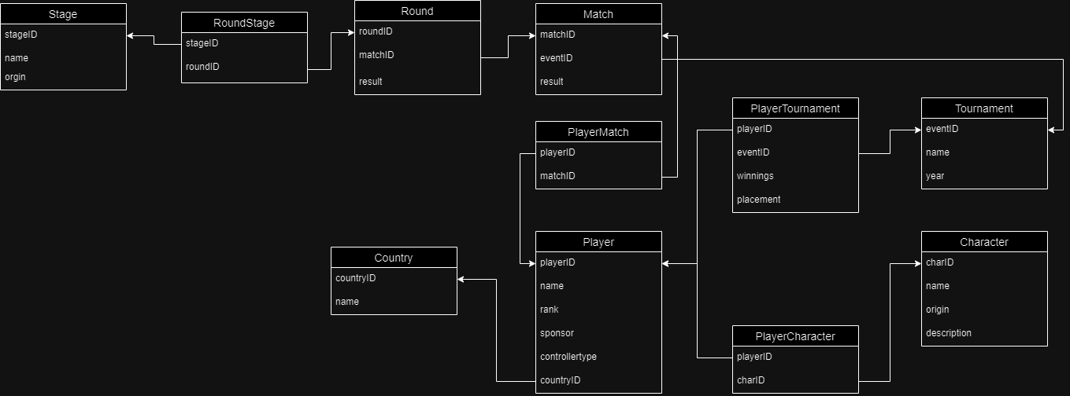
Relation Schema

